Slide 1
Ion Torrent™ – Run Analysis and Introduction to the Torrent Browser
Torrent Suite™ v5.0.2

Slide 2

Objectives for this part of the Training
Introduction of Torrent Suite™ 5.0 Software
Understanding each step of the process
Be able to monitor a run
Be able to review a run report and validate the run
Be able to export the CSA file, and the report file
Be able to reanalyze a run
Notes:
Needs to be adapted per session – Here LAB
How do we do that? And Time frames
We will go into the lab!
X
How does this relate to your expectations – trainer to refer to flipcharts with expectations
Anything we need to or can add?
Needs to be in the update loop when content = description will change

Slide 3



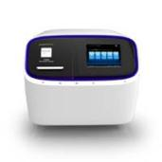
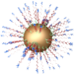
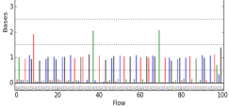

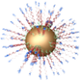

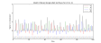
Ion Workflow Overview
A
DNA
B
Compatible Library Prep
C
10
Template Prep
10
Prepare
Library
Clonal
Amplification
Isolate Positive
Ion Sphere™
Particles
Load Chip
and Sequence
D
Data Analysis
Sequencing
E
Compatible Data
Notes:
Ion Torrent Systems, Inc.
3

Slide 4
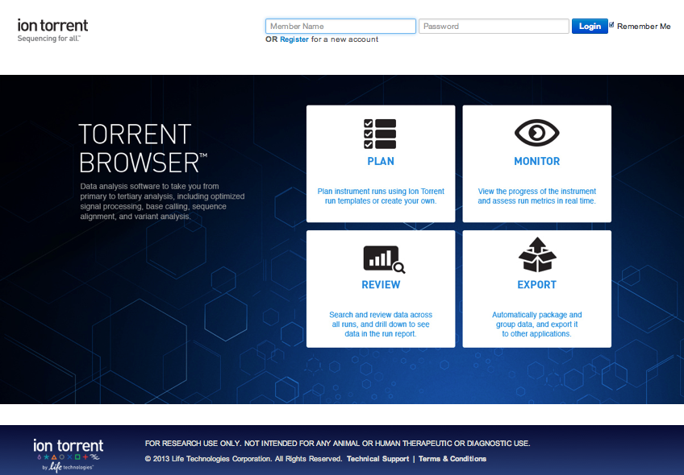

Slide 5
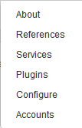
Log into Torrent browser
Site/Server name (configurable)
3 main tabs
Plan: Set up your run
Monitor: Check your run in real time
Data: Analyze your run report(s)
Notes:
How to add the Site/Server name to the Torrent Browser:
FYI: The name is arbitrary and can be whatever the customer would like
Go to Configure
Go to “Customize Site Name” and enter the desired name
Click “Save Name”

Slide 6
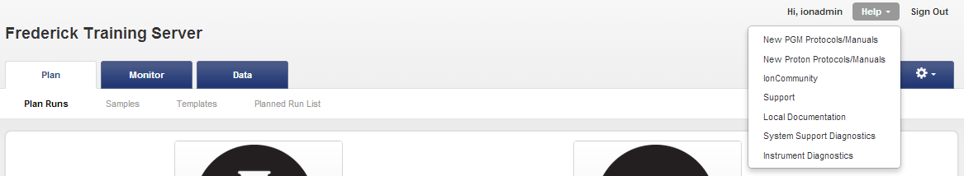
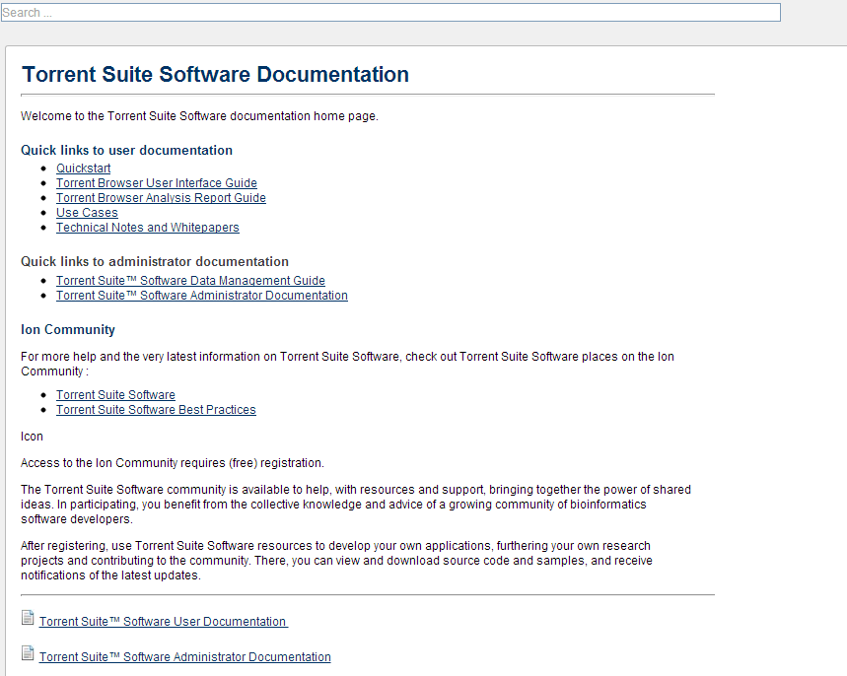
Choose your documentation search method

Slide 7
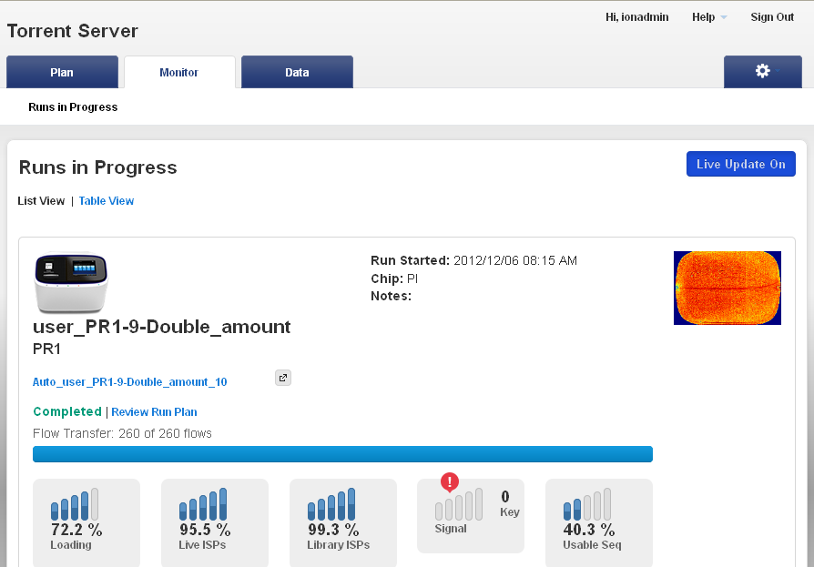
Monitor Tab
Information is populated in real time
Notes:
Run stays on Monitor tab for 6 hrs. After that, view run in Data tab.
7

Slide 8
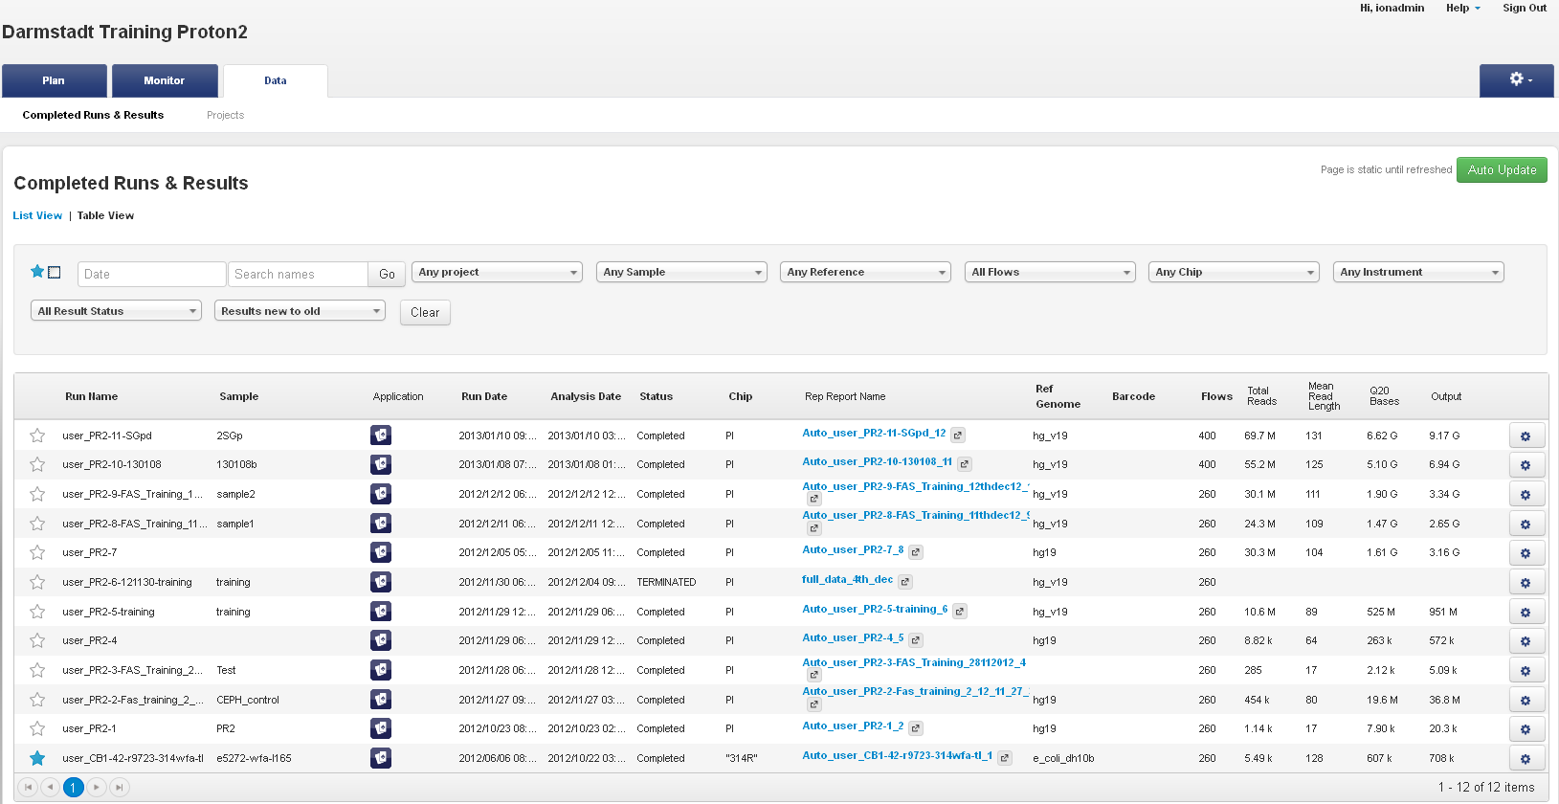
Data Tab – Table View & List View
Table View is useful for scanning,
searching, or sorting a large number of results

Slide 9
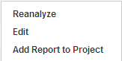
Data Tab – Table View & List View
Search by run name,
run date, chip type, etc.
Table of Runs
& Run Reports
Click to see run report

Slide 10
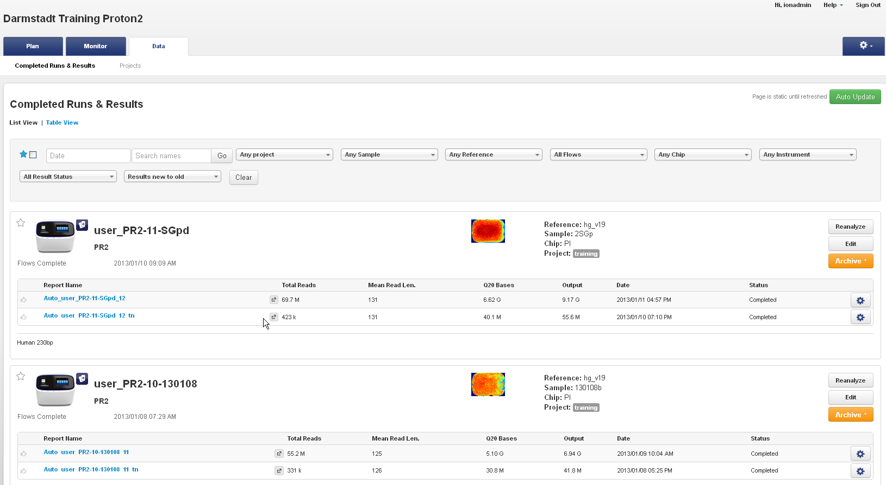
Data Tab – Table View & List View
Click to see run report
Open a report

Slide 11
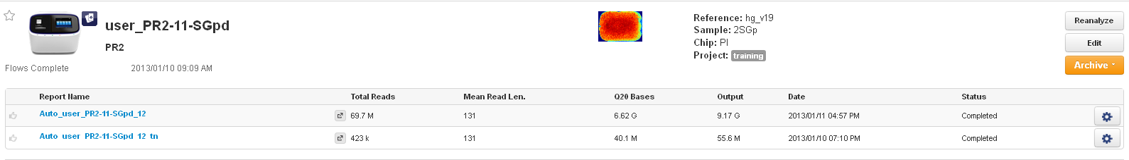
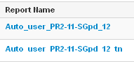
Full report with final metrics
Thumbnail report, generated fast giving you an estimation of the metrics before the entire analysis is performed
(1/171 of the chip)
960,000 out of 164,699,136 wells

Slide 12
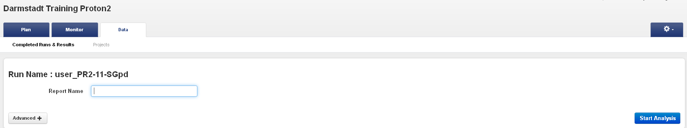
How to reanalyze a run?
1
2
3

Slide 13
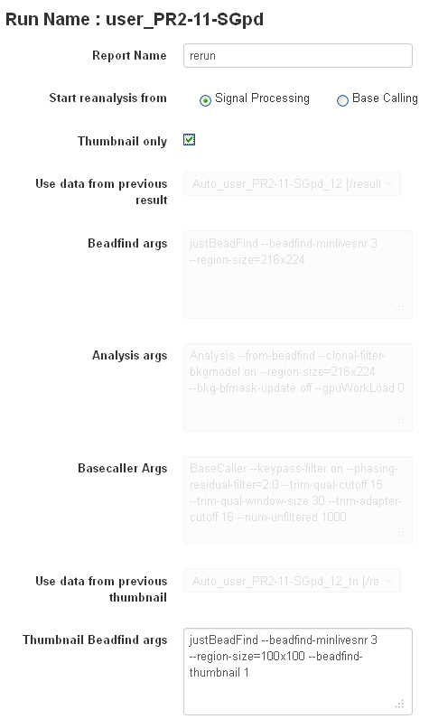
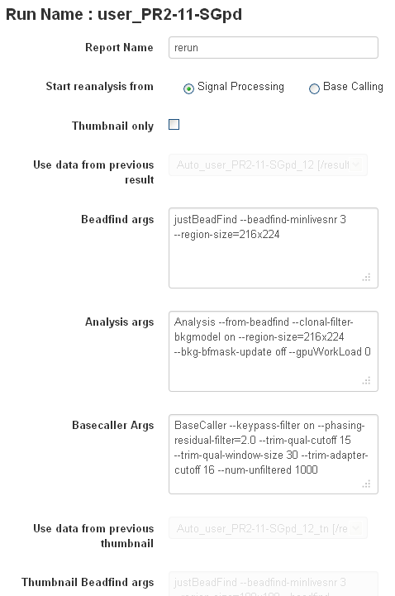
Unclick Thumbnail

Slide 14

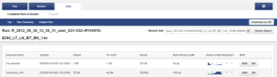
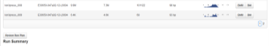
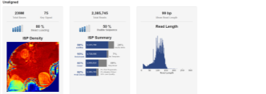
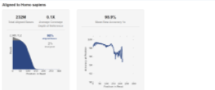
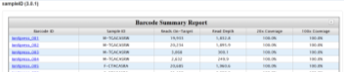
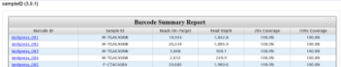
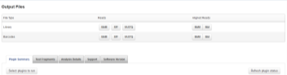
Run Report - Overview
Navigation bar
Barcoding table
(if applicable)
Unaligned/
Aligned metrics
Plugin summaries
Output files

Slide 15
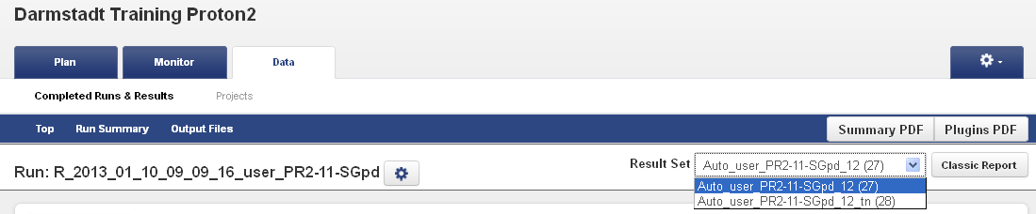
Run Report – Top
Navigate run report
See other run reports
for this run*
* Most recent analysis defaults as representative run report.
User can change representative run report.

Slide 16
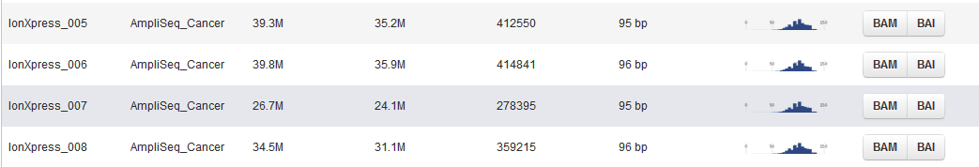
Run Report – Barcoding information (if used)
For each Barcode, we show
Total output
AQ20 Bases
AQ20 reads
Mean AQ20 read length

Slide 17
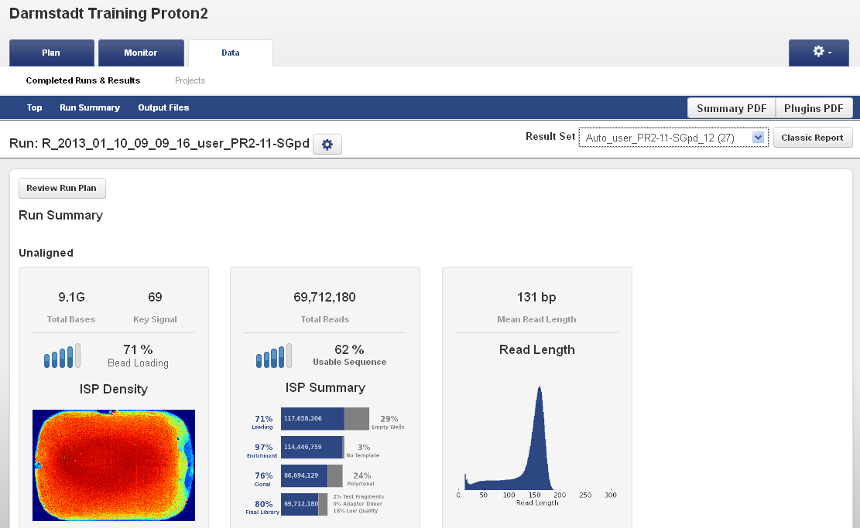
Run Report – Summary of Unaligned reads
Efficiency of chip loading
Percentage of wells that
generated reads that
passed filtering
Average read lengths
Information about bases and reads before mapping
Notes:
2/2/2017
17

Slide 18
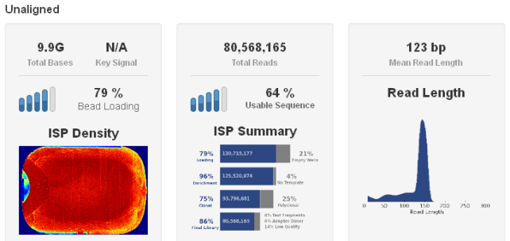
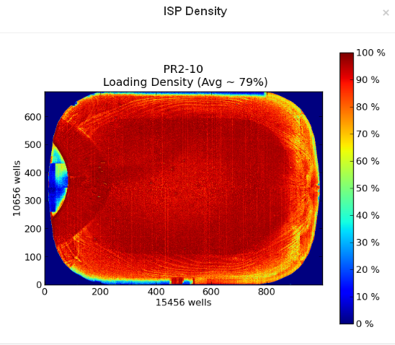
Chip Loading Image: Very Good Loading Example
Ion PI™ chip heat map,
indicating percent loading across
the physical surface
Notes:
2/2/2017
18

Slide 19
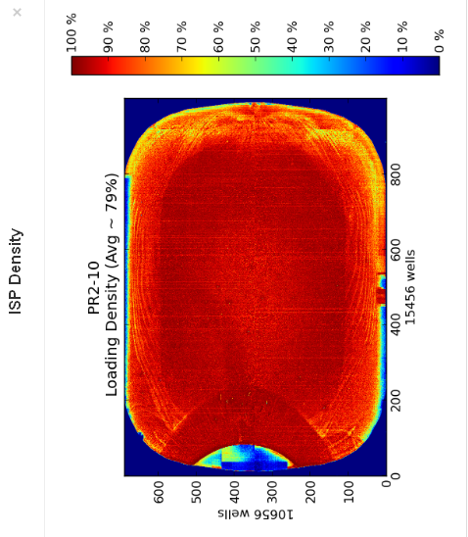
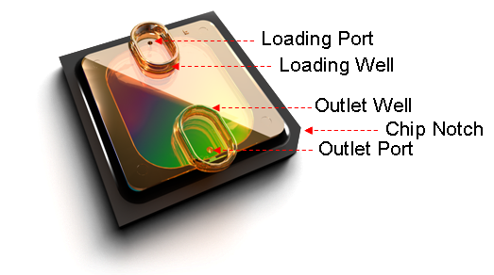
Chip Loading Image: Very Good Loading Example
Sample Loading port
Direction of the reagent flows
Notch
Notes:
2/2/2017
19

Slide 20
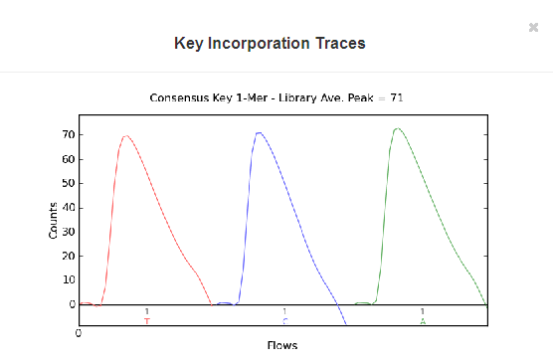
Run Report– Key Signal
The Consensus Key 1-Mer graph shows the strength of the signal from the first three one-mer bases of the library key. This graph represents the consensus signal measurement of release of H+ during nucleotide incorporation. The y-axis shows signal strength, measured in Counts, which is an arbitrary but consistent unit of measure. The x-axis shows time as nucleotide Flows over the chip.
Notes:
2/2/2017
20

Slide 21
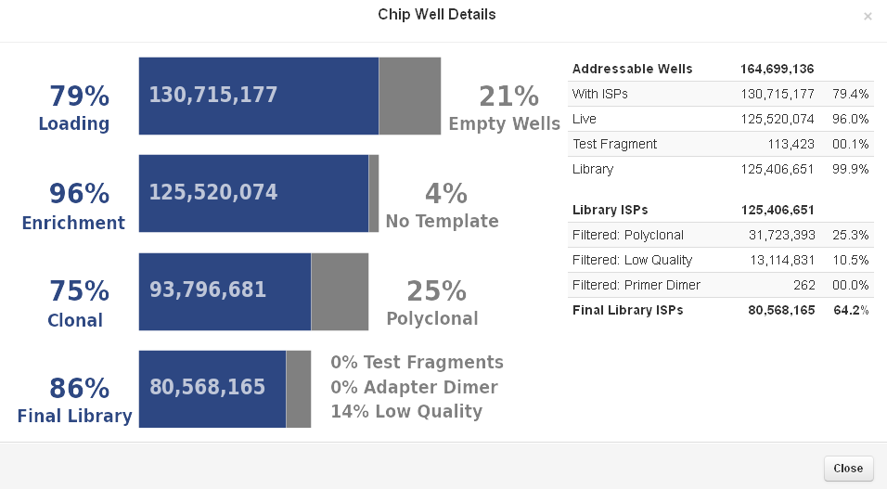
Run Report – Chip Well Details
Measure Loading Performance and enrichment efficiency
First Pass Counting & Grouping (Library or Test Fragment) Ion Sphere™ Particles
Notes:
Please consult the Analysis Report Description for the most accurate explanation of what each of these values represents
2/2/2017
21

Slide 22
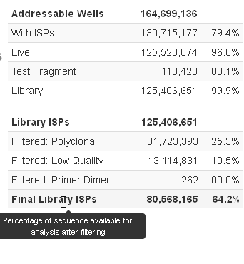
Ion Sphere™ Particle (ISP) Identification Summary
164 699 136
Wells with ISPs
130 715 177
Empty
Too weak signal
Live ISPs
125 520 074
Lib ISPs
125 406 651
(key differentiation)
TF ISPs
113 423
(TCAG)
(ATCG)
Mouse over for help
Polyclonal
Primer dimer
Low quality
Lib reads
80 568 165
Notes:
22

Slide 23
Ion Sphere™ Particle (ISP) Identification Enrichment Calculation
Lib ISPs
125,406,651
% enrich=
(
Wells with ISPs
130,715,177
-
TF ISPs
113,423
)
Notes:
23

Slide 24
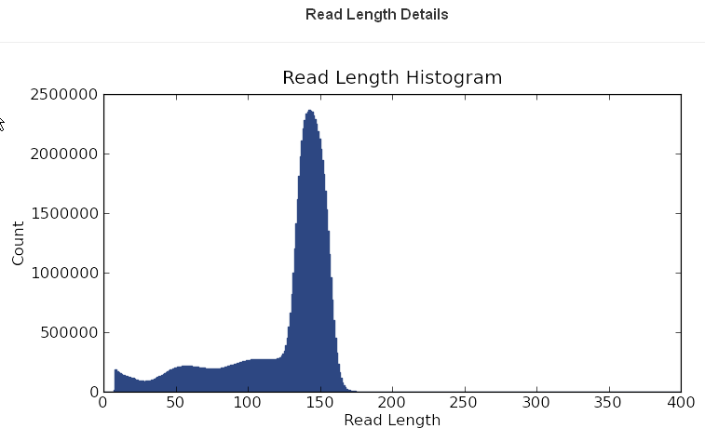
Run Report – Read Length Details
Histogram of trimmed read length for all reads in output files
Notes:
Just an example of some of the graphical outputs in the report. No need to describe details during this presentation. It will be covered during the Torrent Browser training.
FYI the little shoulder peak is normal and is seen following calibration to faster flow. [Chuck S can give a sentence to explain as I didn’t quite get it]
Note that trimming improves overall read quality and may shorten read lengths (lower histogram).
2/2/2017
24

Slide 25
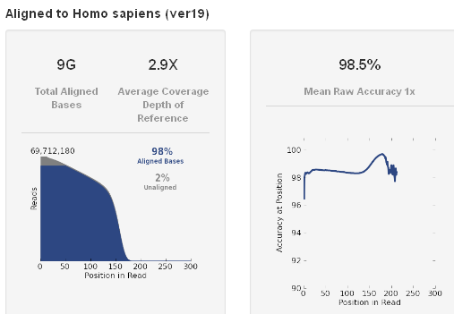
Run Report – Reads Aligned to Reference
Shows metrics that can be gathered after mapping to reference

Slide 26
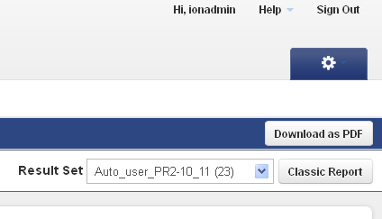
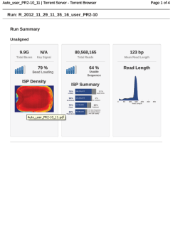
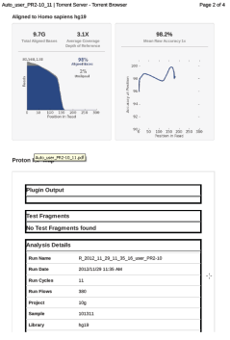
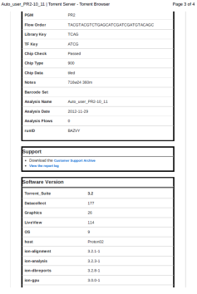
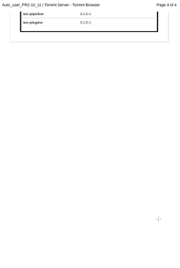
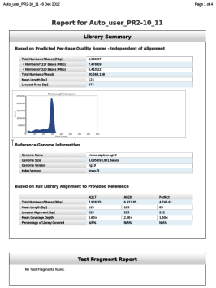
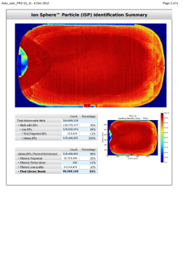
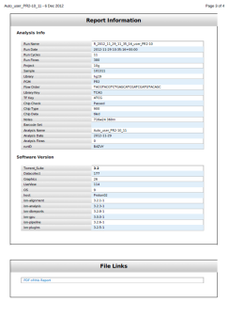
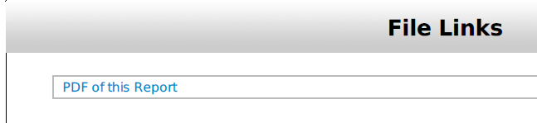
Run report links
*File format of older software version (Torrent Suite™ Software 2.2 or earlier)

Slide 27
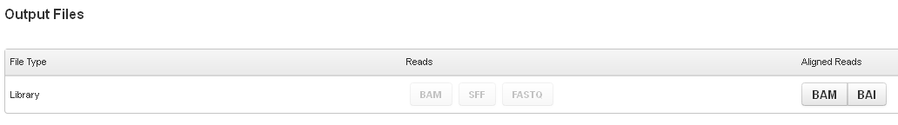
Run Report – Links
File formats produced for extensive data analysis via third party software packages (offered on Webstore) or other bioinformatics tools.
Notes:
Show customers how easy it is to access the processed data – you just click on the links! The Excel export function is very useful as well for tracking multiple run metrics over time.
Make sure to point out Support Archive.
2/2/2017
27

Slide 28
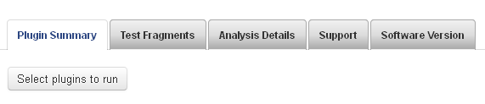
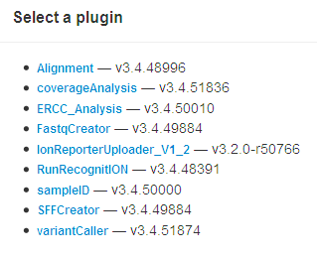
Plugin Summary
variantCaller Features
Supports Ion TargetSeq™, Ion AmpliSeq™, & whole genome applications Each may be run as Germ Line or Somatic
Enables calling for all custom products Supports any genome or custom BED file
Summarizes statistics for barcodes, coverage, chromosomes, variants & hotspots
Calls at 5% or 50%
Compatible with barcoded samples
Planning page for automatic variant calling

Slide 29
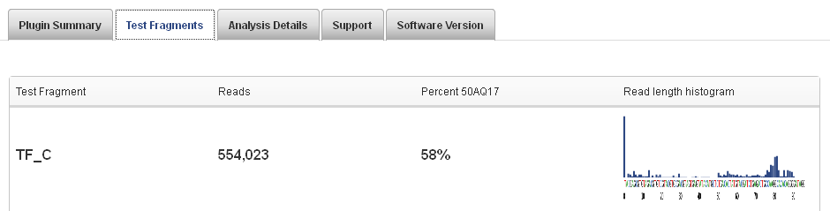
Test Fragment Summary
Notes:
29

Slide 30

Report Information
Notes:
30

Slide 31

Report Information
Notes:
31

Slide 32

Customer Support Archive (CSA)
Files for Troubleshooting;
useful for Technical Support

Slide 33



Reviewing Data - Projects
Project = set of runs

Slide 34


About Link
Notes:
34

Slide 35






References Link
Notes:
35

Slide 36

Services Link
Notes:
36

Slide 37

Services Link
Notes:
37

Slide 38

Configure Link
Notes:
38

Slide 39


Slide 40




Server and Instrument upgrade
… With Admin rights….. (“Ionadmin” by default)….

Slide 41



Server and Instrument upgrade
1
2
Options/update menu

Slide 42


Ion Torrent™ : Semiconductor Sequencing for Life™
Support
Robert David
6178723352
Robert.David@thermofisher
ionsupport@lifetech.com
Call 800-955-6288 in USA
Bioinformatics support
ngs-amsupport@lifetech.com
Jingwei.Ni@thermofisher.com
Online info for Ion Torrent Systems Thermofisher Ion Community
The Chip is the Machine™
Notes:
PLEASE CHANGE TECH SUPPORT NUMBER TO MATCH YOUR REGION’S CONTACT INFORMATION – THIS IS US-ONLY

Slide 43

For Research Use Only. Not for use in diagnostic procedures.
Ion Torrent™ is a Thermo Fisher Scientific brand. © 2014 Thermo Fisher Scientific, Inc. All rights reserved. TaqMan is a registered trademark of Roche Molecular Systems, Inc., used under permission and license. All other trademarks are the property of Thermo Fisher Scientific and its subsidiaries.

